Slide 1

Calorie Detector System
Submitted By,
M. Udaya Shankar(19IT51)
Department of Information Technology

Slide 2
CONTENTS
Objective
Introduction
Existing system
Proposed system
Literature survey
Functional implementation
Expected outcome
Implementation screenshots

Slide 3
OBJECTIVE
To identify the food accurately based on the images of food.
To measure the calorie of the food automatically.

Slide 4
INTRODUCTION
In general, people lack in understanding the links between diet and health
We propose a model, which integrates our mobile calorie measurement application to the deep neural network.
Our proposed Convolutional Neural Network (CNN) with TENSORFLOW algorithm .
The combination of different segmentation method such as color, texture, graph-cut segmentation and deep learning neural network combination.

Slide 5
EXISTING SYSTEM
Food used to portioned and search by segmentation process using Discreet cosine transform then used to classify by K-NN(k nearest neighbor) by that it takes much time trainee the images and classify no proper data been assumed more data loss may occur.

Slide 6
PROPOSED SYSTEM
The steps in image processing are
1. Pre-processing and
2. Neural Network Training.
From this, the trained model can be obtained which will classify any supplied image based on the trained database .

Slide 7
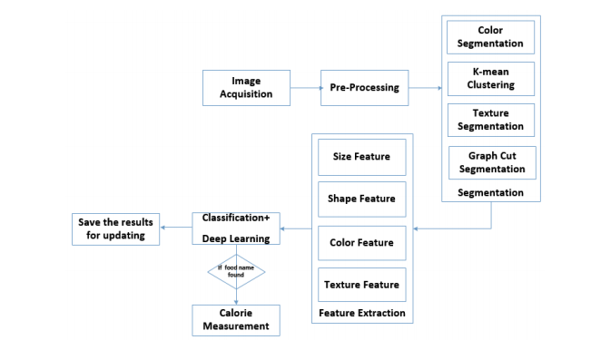
FUNCTIONAL IMPLEMENTATION

Slide 8
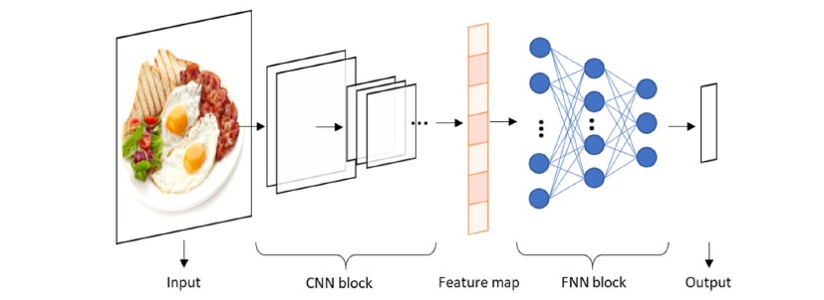
Block Diagram

Slide 9


Implementation Screenshot

Slide 10
LITERATURE SURVEY
Title | Year | Author | Methodology | Advantages | Disadvantages
Combining Local and Global Correlation for Texture Description | 2012 | Xiaopeng Hong 1 Guoying Zhao 1 Matti Pietik¨ainen 1 Xilin Chen IEEE | This paper develops a powerful descriptor, named COV-LBP. Firstly, we propose a variant of LBPs on Euclidean space, named the LBP Difference feature (LBPD), which can be used to calculate any statistical image description. LBPD reflects how far one LBP lies from the LBP mean of a given image. | It motivates to encode the information of LBP differences and hence the texture informations can be accurately got. | Euclidean distance on LBPs could not reflect the topological structure of LBPs precisely,

Slide 11
Title | Year | Author | Methodology | Advantages | Disadvantages
Noise-Resistant Local Binary Pattern with an Embedded Error-Correction Mechanism | 2013 | Jianfeng Ren Xudong Jiang and Junsong Yuan, IEEE | In view of this, we propose a noise-resistant LBP (NRLBP) to preserve the image local structures in presence of noise. The small pixel difference is vulnerable to noise. Thus, we encode it as anuncertainstate first, and then determine its value based on the other bits of the LBP code. It is widely accepted that most image local structures are represented by uniform codes and noise patterns most likely fall into non-uniform codes. | The exact intensities are discarded, and only the relative intensities with respect to the center are preserved. | LTP is not invariant under scaling of intensity values

Slide 12
Title | Year | Author | Methodology | Advantages | Disadvantages
Snake Texture Classification Using BRINT | 2015 | Keerthana A.V #1 , Udaya Shankar M IEEE | Here feature extraction has been done with local binary pattern (LBP) approach where computed local binary descriptor. These descriptors points are sampled in a circular neighborhood and provided single-scale LBP histograms. In this approach there is not needed dictionary constructor because of using different datasets. | It is applicable for discriminative and robust combination for multi resolution analysis. | This is a drawback in some regression tasks with multi-dimension outputs (e.g. human body pose estimation),

Slide 13
Title | Year | Author | Methodology | Advantages | Disadvantages
Rotation-Invariant Image and Video Description With Local Binary Pattern Features | 2012 | Guoying Zhao, Timo Ahonen, Jiř í Matas, and Matti Pietikäinen IEEE | In this paper, we propose anovel approach to compute rotation-invariant features from histograms of local noninvariant patterns. We apply this approach to both static and dynamic local binary pattern (LBP) descriptors. For static-texture description, we present LBP histogram Fourier (LBP-HF) features, and for dy-namic-texture recognition | The proposed two rotation-invariant LBP-TOP descriptors inherit the advantage of the original LBP-TOP | it is not rotation invariant

